Slide 1

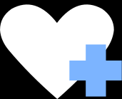

Project:
Patient Tracking and Disease Management System
Goal:
To develop a PL/SQL-based system that tracks patients, diseases, and treatments efficiently.

Slide 2



Problem Identification
Critical Challenges Identified:
  Fragmented patient records
  Poor disease trend monitoring
  Lack of real-time analytics
  No structured error tracking
Why This Phase Was Important:
This phase defined the real-world healthcare gap that the system was designed to solve.

Slide 3

Logical System Analysis
What Was Analyzed
  Hospital data workflow
  spread of diseases
  Treatment documentation process
Key Outcome:
A structured understanding of how patient data moves across hospital departments.

Slide 4
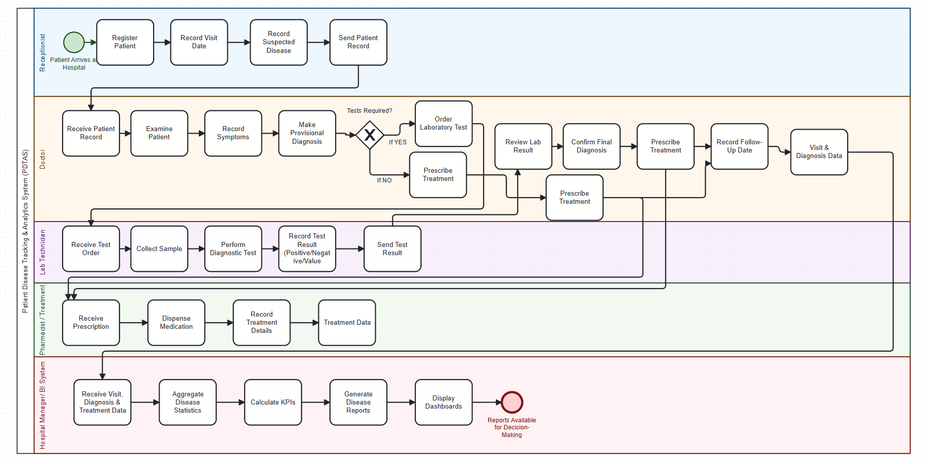

Slide 5

SystemEngineering
Advanced Implementations:
  Custom exception architecture
  Package-based encapsulation
  Cursor-based data processing
  Robust error logging mechanisms
Why This Is Serious:
This phase demonstrates backend-level engineering, not just basic SQL queries.

Slide 6
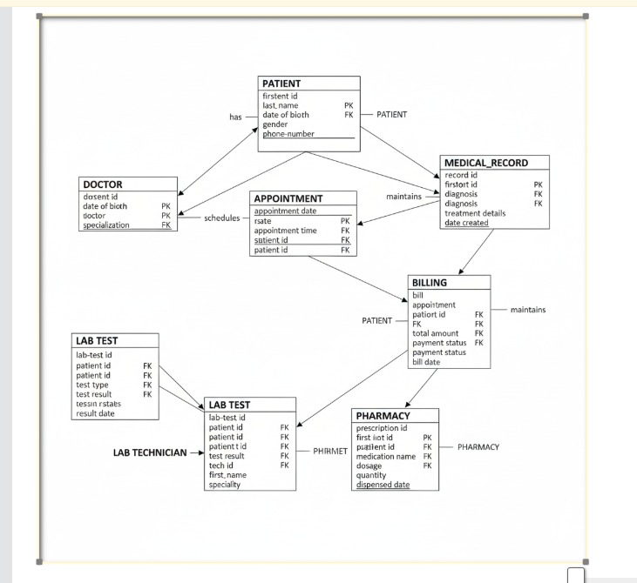

Slide 7

: Controlled Testing Strategy
Testing Approach:
  Structured unit tests per procedure
  Boundary condition testing
  Exception scenario simulation
Measured Outputs:
  System stability
  Error resilience
  Data integrity

Slide 8


Intelligent Data Analytics
Value Created:
  Disease frequency ranking
  Patient visit trend analysis
  Temporal health pattern identification
Enables predictive-style healthcare insights.
Technology Used:
Reliability Mechanisms:
SQL Window Functions (ROW_NUMBER, RANK, DENSE_RANK, LAG, LEAD)

Slide 9

Impact and Strategic Contribution
Database programming
PL/SQLarchitectural design
Analytical data modeling

Slide 10

Conclusion
This project successfully demonstrates how structured database engineering and PL/SQL intelligence can transform hospital data into a reliable, analytical, and decision-support system.

Slide 11

HUMURE ENOCK
27394
THANK YOU!!

